Slide 1
Manuscript Flow
Overall scientific objective
Genetics of BXSB as a mouse model of SLE
Key questions
What are the causal variants of SLE in BXSB mouse model?
What are the functional consequences of the causal variants?
Gene expression level
Pathway level (KEGG & IMMGEN)

Slide 2
Overview of BXSB mouse model

Slide 3
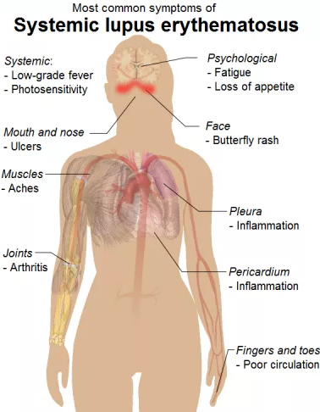
Systemic lupus erythematosus (SLE)
SLE or lupus is a autoimmune disease in which the body’s immune system attacking healthy tissues
Lupus causes inflammation in multiple organs and a wide variety of symptoms
Global prevalence from 20 to 70 per 100,000
It occurs 9 times more often in women than in men
There is no cure
Genetics play a role in susceptibility
Mouse model: male BXSB develops spontaneous lupus-like autoimmune syndrome

Slide 4
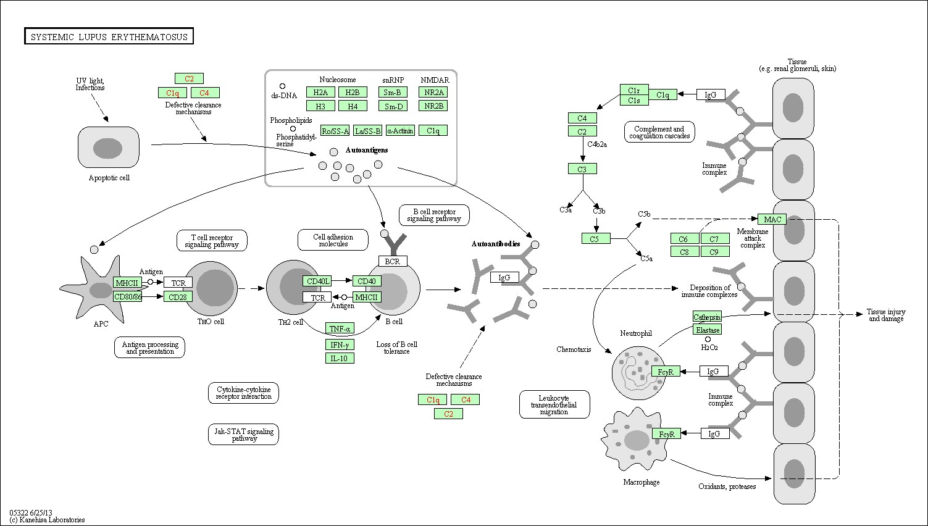
KEGG: SLE

Slide 5
Introduction of BXSB mouse strain
breakpoint
Chromosome Y (C3H)
YAA (B6)
PAR (B6)
Chromosome X (B6)
YAA (B6)
PAR (B6)
YAA: Y chromosome-linked autoimmune acceleration
PAR: pseudo-autosomal region
BXSB is an inbred strain by intercrossing progenies of B6 females to SB male
BXSB autosomes are mosaic of B6 and SB, BXSB sex chromosomes are illustrated as above
Yaa mutation in SB: translocation from telomeric end of the X onto the Y chromosome
Yaa locus and BXSB genomic background both relevant to SLE development
Genetic mechanisms are not clear

Slide 6
Yaa context: 10 Mbp telomeric end of X chromosome
PAR
PAR: pseudo-autosome region of chromosome X and Y pair and recombine during meiosis (0.96 and 0.90 Mbp)
TLR7/8 are active drug targets of SLE, with extensive human genetics evidences.

Slide 7
Yaa context: 10 Mbp telomeric end of Y chromosome
PAR

Slide 8
Genomic variants in BXSB mice

Slide 9
Materials and Methods
Exome sequencing of BXSB mouse
FASTQ trim
Alignment: Bowtie
Variant call
samtools, GATK, VarScan
BXSB pseudo-genome
BXSB.B6Y males carry the B6 Y chromosome in place of the mutant Yaa-containing Y chromosome of BXSB inbred male mice.

Slide 10
Genomic differences of B6 and BXSB
Some of these variants collaborate with the YAA locus to elicit the SLE symptoms.
What are they?
How can we approach this question?

Slide 11
Predict variant’s effect

Slide 12
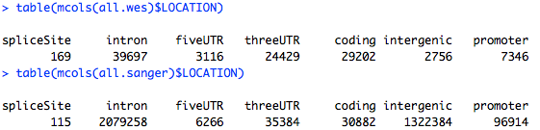
Two sources of BXSB variants: Sanger and JAX/wes
15083 coding variants from JAX/wes, and 16707 coding variants from Sanger
12441 shared coding variants (75% of Sanger and 82% of JAX/wes)

Slide 13
GWAS results of SLE
Human genetics evidences from association studies of SLE can help identify causal variants and genes in BXSB mouse model

Slide 14
Functional consequences of causal variants in gene expression

Slide 15
Materials and Methods
RNA sequencing
BXSB, BXSB^{B6Y}
Microarray
B6, B6^{YAA}
FASTQ trim
Normalization (RMA)
Alignment: Bowtie
B6 and BXSB pseudo-genome
DE genes
Expression estimation: RSEM
DE, pathway, Immgen
Microarray: CD3CD4 T-cells
RNA sequencing: Splenic cells from 10 week old BXSB and BXSB.B6Y
BXSB.B6Y males carry the B6 Y chromosome in place of the mutant Yaa-containing Y chromosome of BXSB inbred male mice.
What we get?
Effects of YAA on gene expression on the B6 genomic background (Microarray)
Effects of YAA on gene expression on the BXSB genomic background (RNA sequencing)
Because tissues do not match, might be better stick on one dataset for a clean / focused story

Slide 16
RNA sequencing on BXSB and BXSB^{B6Y}
BXSB.B6Y by breeding BXSB female with B6 male, so BXSB Y was replaced by B6 Y
Samples: Splenic cells from 10 week old BXSB and BXSB.B6Y (3 and 4, all males)
Pipeline: fastq were trimmed with Trimmomatic, reads were aligned to BXSB pseudo-transcriptome with Bowtie, gene expression levels were estimated with RSEM
Aligning to BXSB pseudo-genome increases alignment rate by approximately 1%
Is the 1% difference in alignment rates causing different estimations on gene expression?

Slide 17
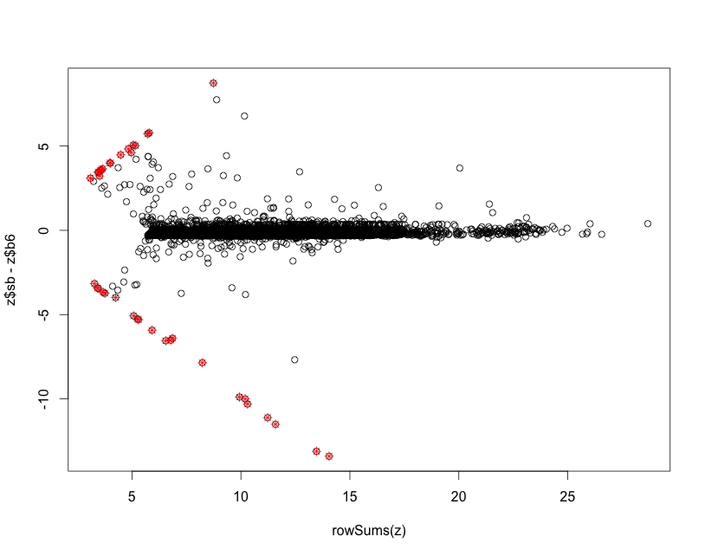
Genes that aligned differently to the B6 and BXSB genomes
X: sum of BXSB and B6 alignments
Y: differences of BXSB and B6 alignments
Minimal TPM 8

Slide 18
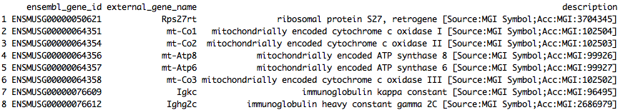
Outlier genes
Igkc and Ighg2c are both annotated for Immunoglobulin (Ig) and T-cell receptor (TcR) Igkc high and twice more in BXSB. Ighg2c higher in BXSB.B6Y. What are they doing?

Slide 19
Outlier genes
I took off the outlier genes and re-normalize the TPM for downstream analysis.

Slide 20
Transcriptional processes in BXSB and BXSB.B6Y splenic cells are very different
q-value < 0.05, log2 fold change > 0.3
1724 out of 9678 are differential
Why the signal so strong?

Slide 21
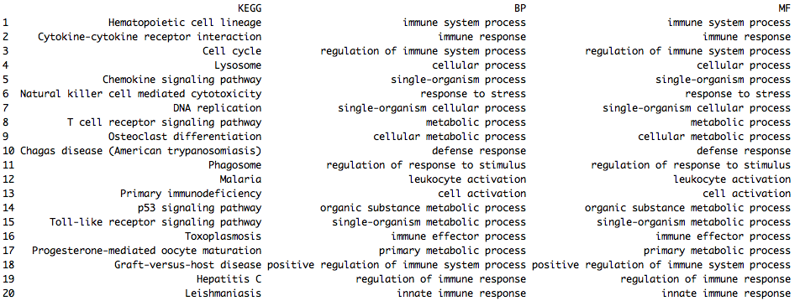
Differential genes are also immunological genes

Slide 22
Transcriptional differences between B6 and B6.YAA
p-value < 0.05
977 out of 21755 are differential

Slide 23
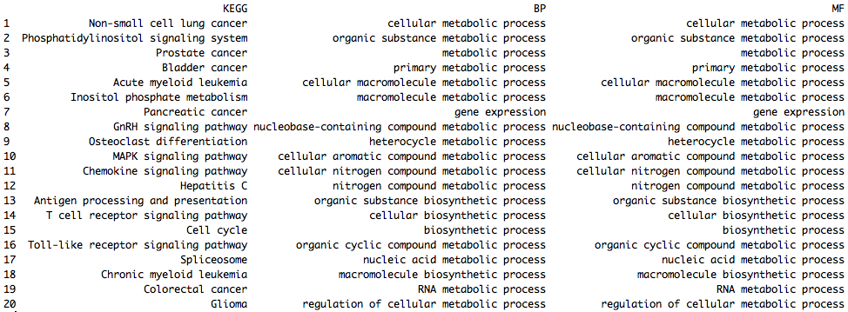
Differential genes are metabolic-related

Slide 24
Interaction between YAA and genomic backgrounds
DE1: Yaa-targeting genes in the B6 background
B6
Yaa-
B6
Yaa+
DE2: Yaa-targeting genes in the BXSB background
BXSB
Yaa-
BXSB
Yaa+
Intersection between DE1 and DE2 are Yaa-genes irrelevant of genomic background
DE2-specific genes reflect interaction between Yaa locus and BXSB genomic background
DE1-specific genes reflect interaction between Yaa locus and B6 genomic background
However, tissues of the microarray and RNA sequencing experiments were different. Are the arguments above still reasonable?

Slide 25
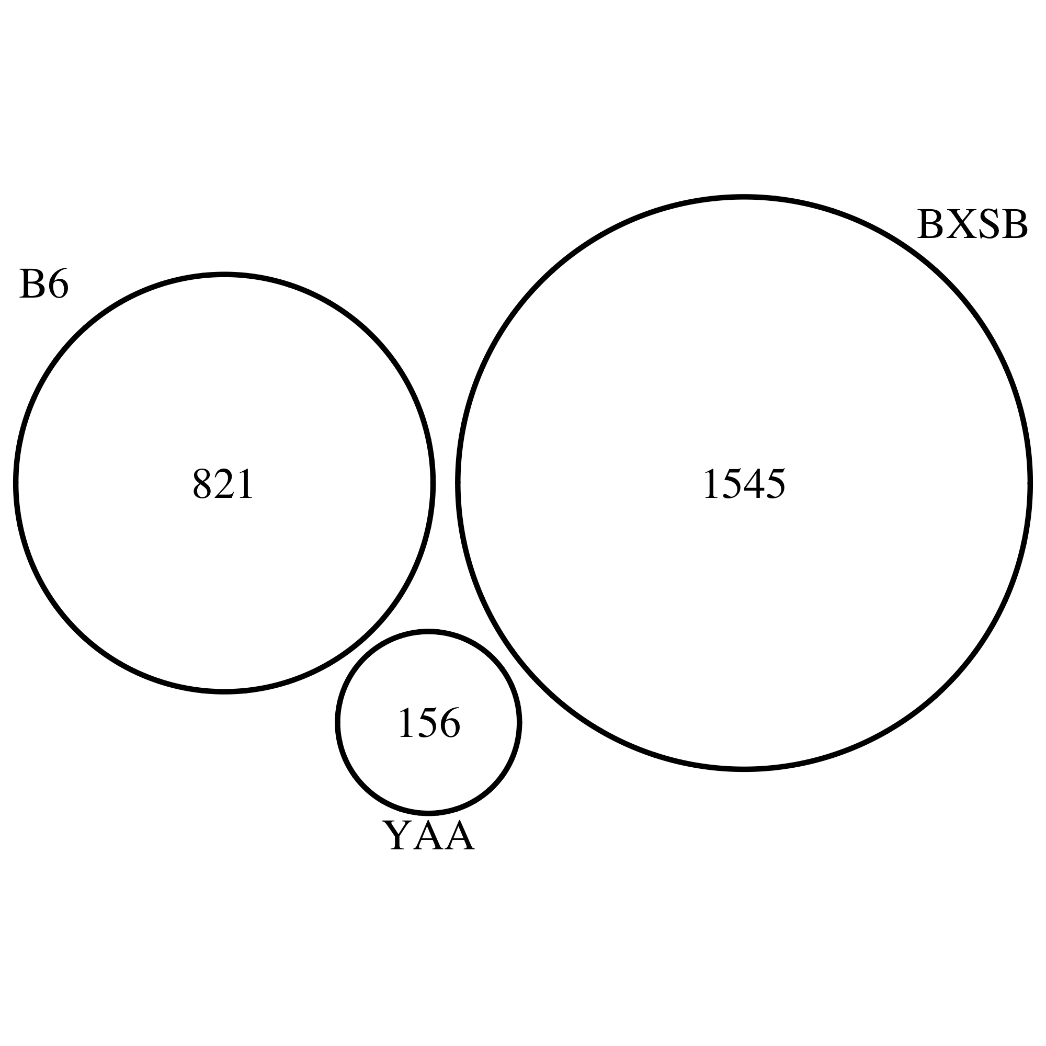
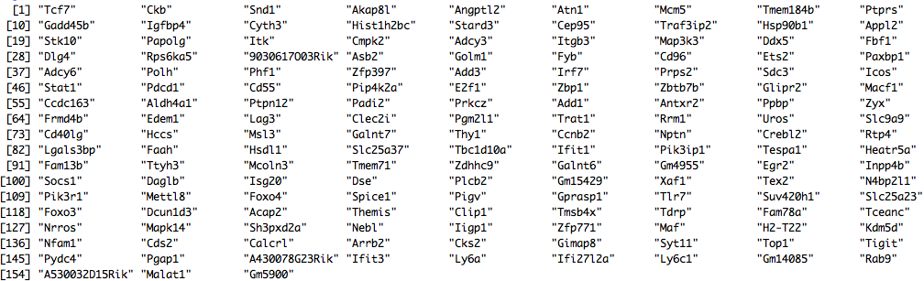
Strong BXSB-specific signal

Slide 26
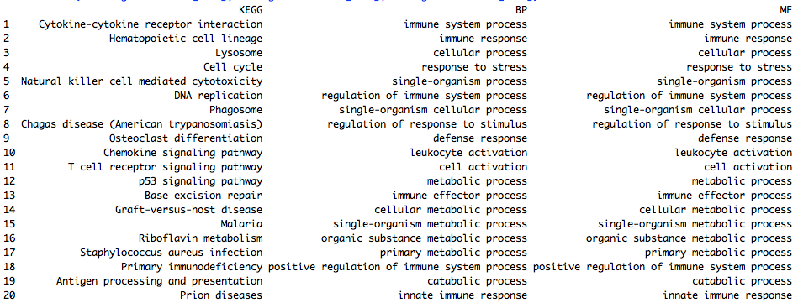
BXSB-specific genes are immunological

Slide 27
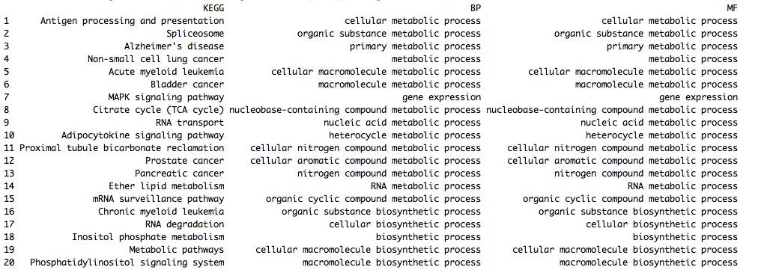
B6-specific genes are metabolic

Slide 28
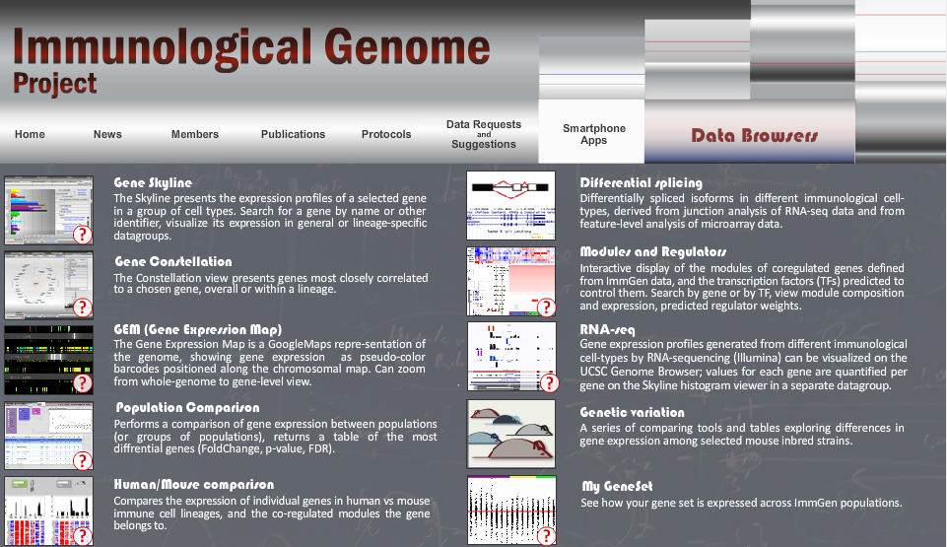
ImmGen modules

Slide 29
BXSB-specific genes in Immgen modules
Top regulators of module 24: Klf9, Tcfec, Ctbp2, Creg1, Tcfe3
Top regulators of module 25: Cebpb, Irf5, Ciita, Atf6

Slide 30
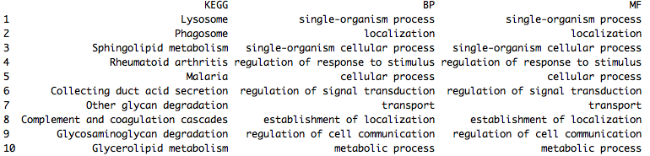
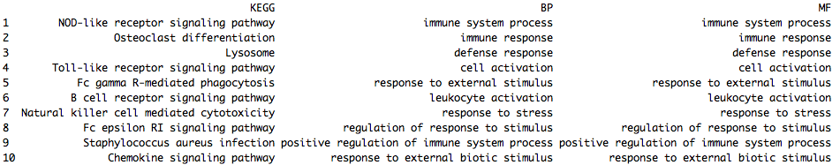
Module 25 is interesting
Module 24
Module 25

Slide 31
Another method to analyze the RNA-sequencing data
Autosomal mutations in BXSB mice contribute to Lupus progression, what are the genes and mutations?
We approach this question in the transcriptome, and exome levels
RNA-seq from spleens of BXSB and BXSB/B6
Aligned to pooled B6/SB hybrid genome
BXSB
BXSB/B6
Gene
B6 allele
SB allele
B6 allele
SB allele
We have two advantages by aligning the RNA-sequencing reads to the hybrid genome:
Higher alignment rate, than use genome of either B6 or SB
Facilitate follow-up interrogations of gene / variant functions

Slide 32
Align to the B6/SB hybrid genome
Pooled the B6 and SB genes together as a hybrid reference genome, to which we aligned the reads of RNA-seq/WES
Always assign the best match
B6::gene1
SB::gene1
B6::gene1
SB::gene1
B6::gene1
SB::gene1
….
….
….
….
B6::gene1
SB::gene1
Genes have no variation in SB should align to the B6 and SB genes similarly
Genes have variations in SB should align preferentially to either B6 or SB genes than depending on the allele types of that gene in BXSB
What about genes that have some region carries the SB allele type, while another region carries the B6 allele type? Would this be rare situation?

Slide 33
What we have detected?
BXSB
BXSB/B6
Gene
B6 allele
SB allele
B6 allele
SB allele
SB and B6 genes preferentially aligned to the SB and B6 alleles, respectively.
YAA genes showed differential RNA levels between BXSB and BXSB/B6 strains
Of course, all the other differentially expressed genes.
Also genes that do not change in transcript abundances, but in function because of the mutations. This asks for a systematic study.

Slide 34
What are the functional consequences?
SB and B6 genes produce different proteins
YAA genes led to different protein amounts

Slide 35
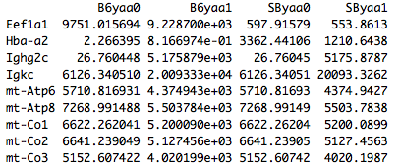
Outlier genes

Slide 36
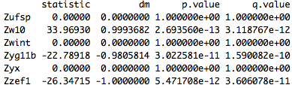
Define the SB genes
Method
Results
“dm” tells proportion of strain-specific alignments; dm = 0.9 means 95% of read for the given genes were aligned strain-specifically

Slide 37
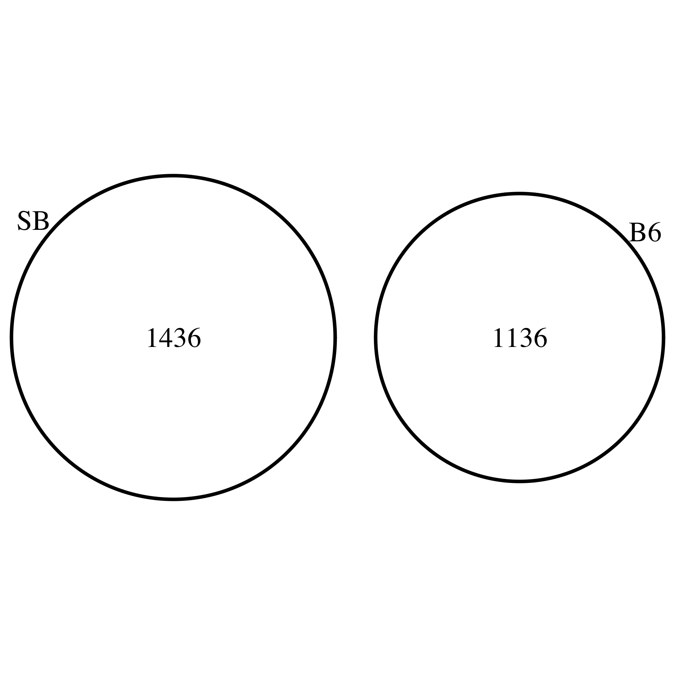
SB genes and B6 genes
SB genes: dm > 0.9, 95% or more reads aligned to the SB allele, q-value 0.05 or less
B6 genes: dm < -0.9, 95% or more reads aligned to the B6 allele, q-value 0.05 or less

Slide 38
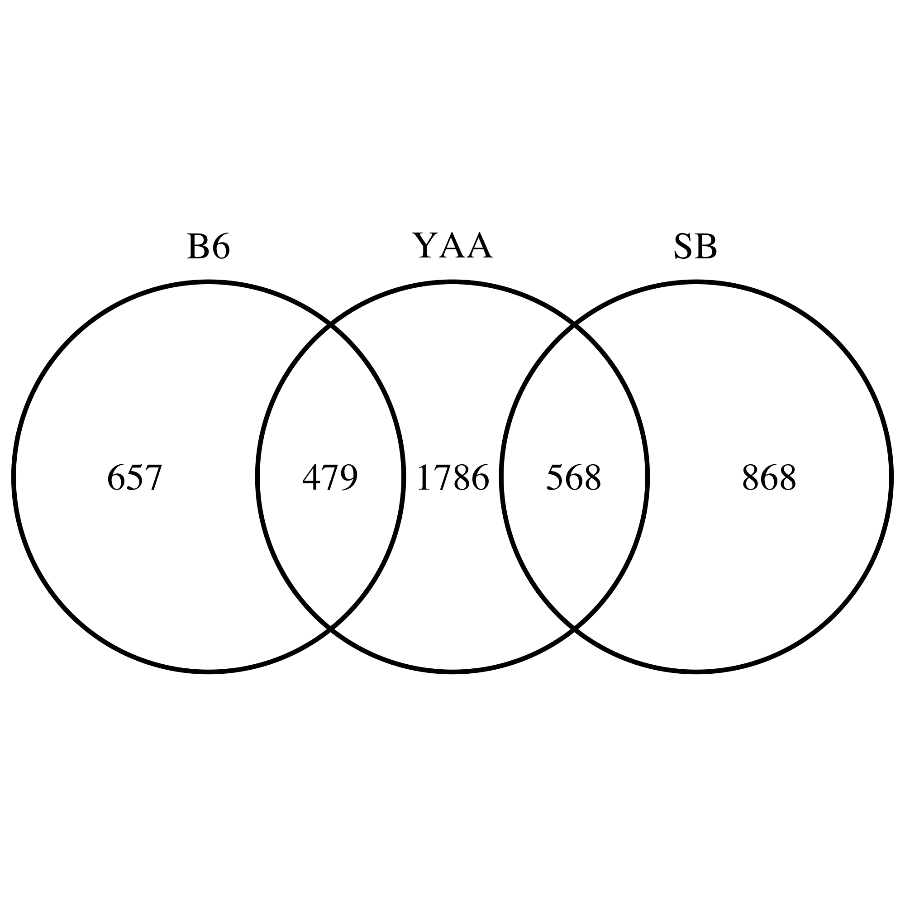
YAA genes
Methods
Merge the B6 and SB alleles for each gene
ttest on log2(tpm) between BXSB and BXSB/B6Y samples (4 and 3)

Slide 39
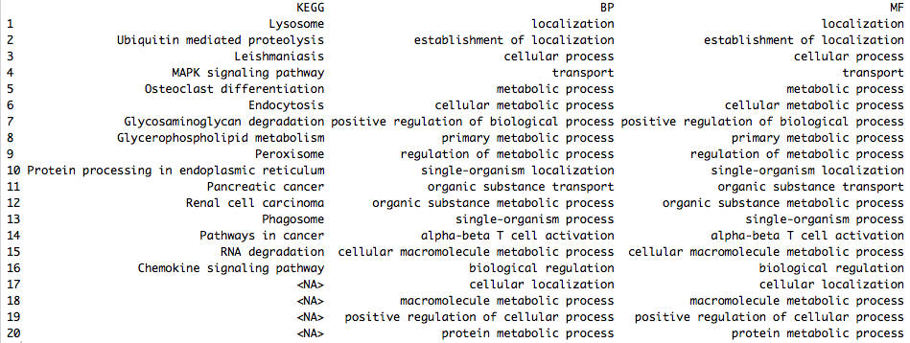
Which gene group matters?
Presumably, SB and B6 genes produced different proteins, while YAA genes led to different amounts of the relevant proteins
568 overlaps between YAA and SB genes: they produced the SB proteins, the protein amounts were further modulated by the extra YAA copy in BXSB Y-chromosome

Slide 40
The potential master regulators

Slide 41
Comparison between the IL21 and YAA samples
Not sure how much the IL21 story is relevant with the BXSB story
Why we think the IL21-positive T cells are important for the BXSB and SLE story?

Slide 42
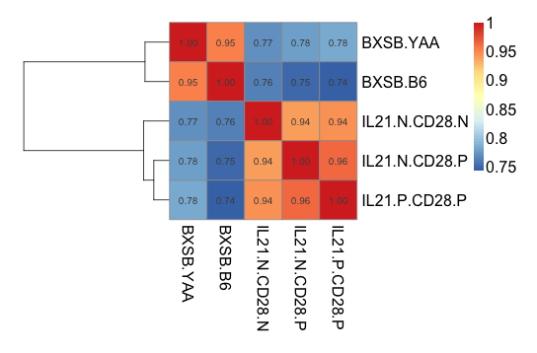
BXSB^{B6} and BXSB^{YAA}

Slide 43
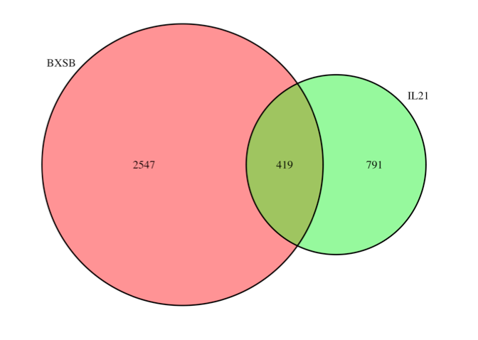
BXSB^{B6} and BXSB^{YAA}

Slide 44
BXSB^{B6} and BXSB^{YAA}
 | IL21^{N}ICOS^{N} | IL21^{N}ICOS^{P} | IL21^{P}ICOS^{P}
BXSB^{B6} | 106*** | 52 | 28
BXSB^{YAA} | 24 | 93 | 116***
Fisher’s test: p value equals 2.2e-16
Chi-square test: p values equal 6.613e-12 and 1.52e-13 for BXSB^{B6} and BXSB^{YAA}

Slide 45
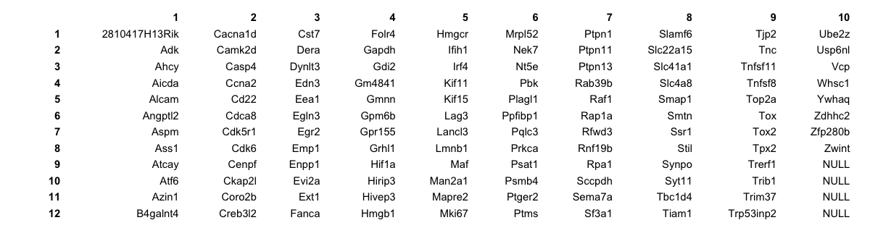
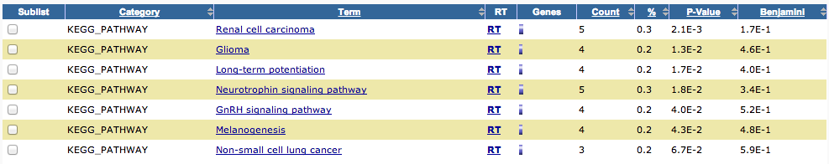
BXSB^{B6} and BXSB^{YAA}

Slide 46
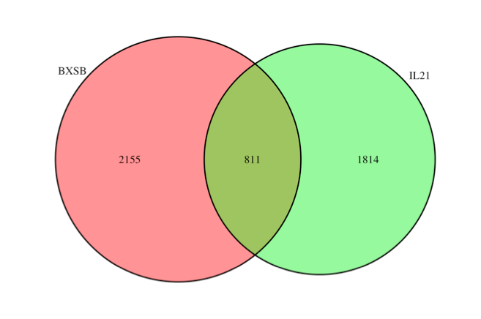
BXSB^{B6} and BXSB^{YAA}

Slide 47
BXSB^{B6} and BXSB^{YAA}
 | IL21^{N}ICOS^{N} | IL21^{N}ICOS^{P} | IL21^{P}ICOS^{P}
BXSB^{B6} | 190*** | 100 | 68
BXSB^{YAA} | 43 | 193 | 217***
Fisher’s test: p value equals 2.2e-16
Chi-square test: p values equal 6.613e-12 and 1.52e-13 for BXSB^{B6} and BXSB^{YAA}

Slide 48
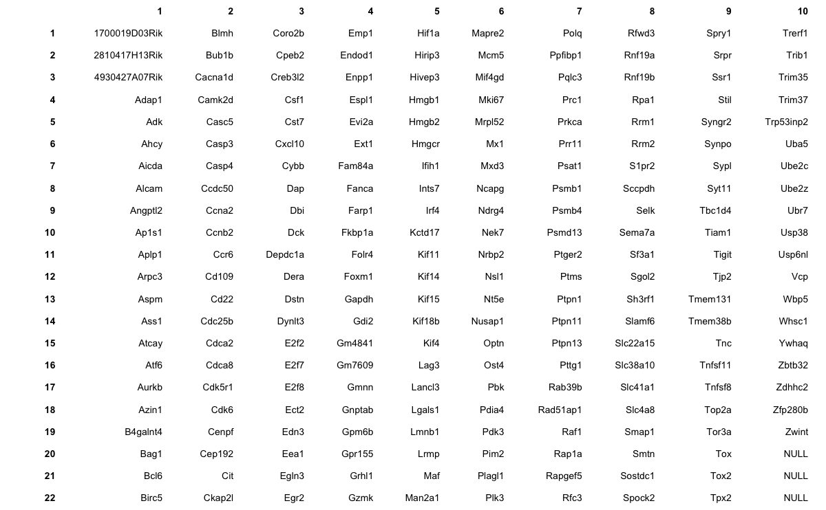
BXSB^{B6} and BXSB^{YAA}

Slide 49
10Mbp +/- Il21 gene (20Mbp in total)
Bottom: Red bar are SB variants, space between red bars are B6 genome
Top: Blue and purple dots are gene expression in TPM for BXSB and BXSB_B6 samples
Each point is a gene. Tried to label them but too crowded. Il21 in the middle

Slide 50
Expression profiles of B and T cells from multiple genetic backgrounds
Effects of BXSB variation on expression profiles of B and T cells
And the additional effects by knocking out IL21R
This part probably does not integrate well with the stuffs above

Slide 51
Experiment design
Gene expression measurement on B/T cells from multiple genetic backgrounds
YAA: backcrossing BXSB male with B6 females
YAA-IL21R: backcrossing BXSB male with B6 female (IL21R-/-)
Gene expression measured by microarray

Slide 52
Batch factors: sample prep date

Slide 53
Il21r
Il21r: protein coding, interleukin 21 receptor, chromosome 7

Slide 54
Nfkb1
Nfkb1: protein coding, nuclear factor of kappa light polypeptide gene enhancer in B cells, chromosome 3
20120530 batch suspicious, took off

Slide 55
Tlr7
Tlr7: protein coding, toll-like receptor 7, chromosome X
Yaa-TLR(-/+) level not low, took off all Tlr7

Slide 56
Samples

Slide 57
Cell type (B/T) signal dominates the data

Slide 58
How much effect batch factor carry?
PCA on T cell samples only (14 samples), batch correlate with major PCA signal

Slide 59
How much effect batch factor carry?

Slide 60
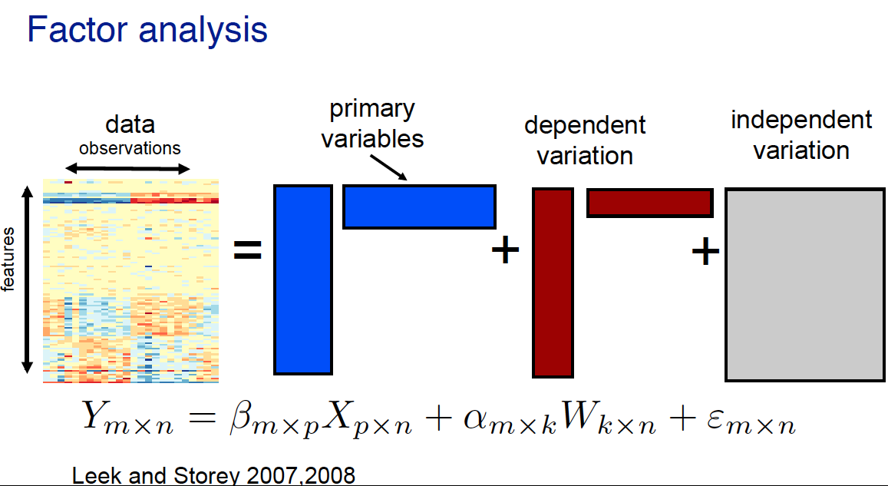
Batch correction by factor analysis

Slide 61
Model
Y ~ cell + genoYaa + genoIL21R + genoNfkb1 + cell * genoYaa + cell * genoIL21R + cell * genoNfkb1
cell: B, T
genoYaa: B6, Yaa
genoIL21R: WT, IL21R
genoNfkb1: WT, Nfkb1

Slide 62
Batch correction by factor analysis

Slide 63
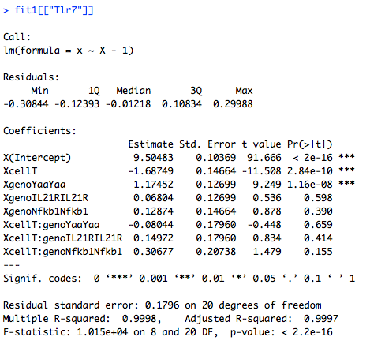
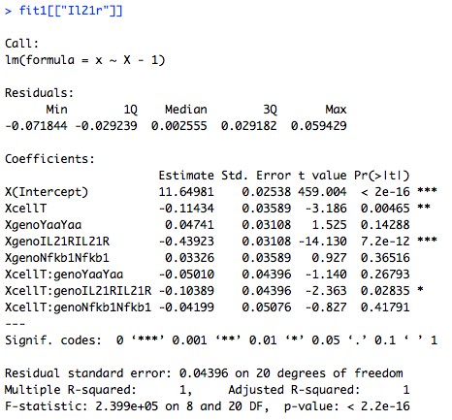
Model fit

Slide 64
Model

Slide 65
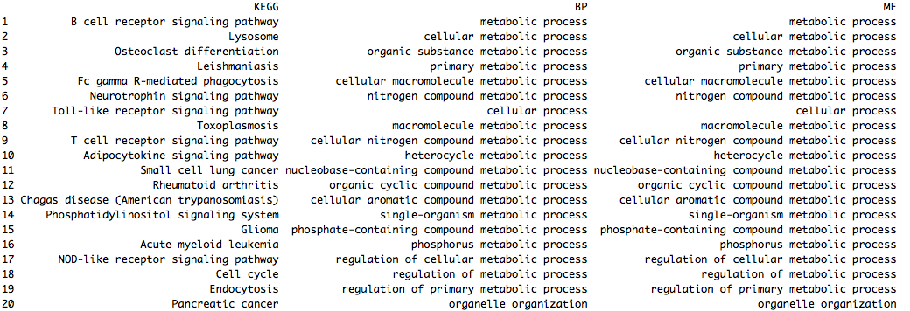
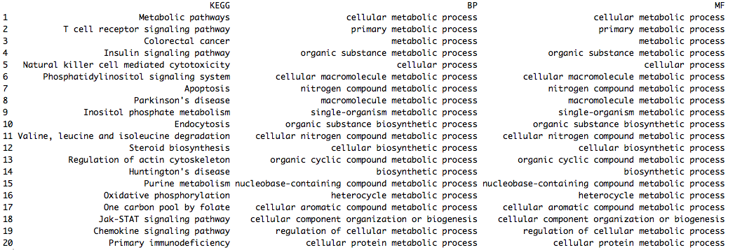
B and T cell genes in B6

Slide 66
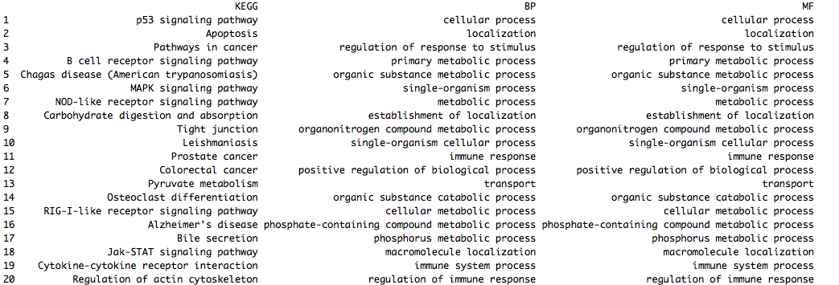
T-cell specific Nfkb1(+/-) effect, conditional on Yaa strain

Slide 67
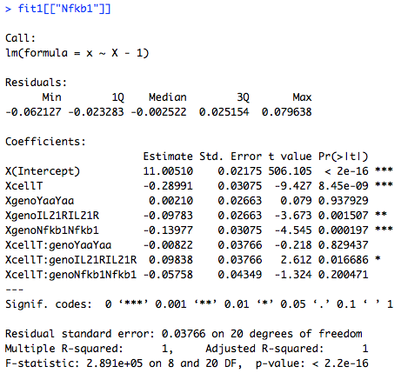
Model fit

